Slide 1
RAPIDO ANALYSIS
Name: Sushmita Patil Department: MCA (BCU) Semester:Third
USN: P18BR23S126010

Slide 2
Outline
Title Name
Outline
Abstract
Problem Statement
Proposed Solution
Short Video
Implementation
Output Screenshots
References

Slide 3
Abstract:
This project focuses on analyzing Rapido trip data to uncover patterns, trends, and insights that can improve operational efficiency and enhance user experience.
we examine key aspects such as ride demand patterns, peak usage times, geographical trip distributions, and fare structures.
Steps include data preprocessing, model training, and evaluation, followed by actionable insights for business decision-making.

Slide 4
Problem Statement
The increasing demand for ride-hailing services like Rapido presents challenges in optimizing operational efficiency, meeting customer expectations, and ensuring equitable driver distribution.
Identifying peak demand periods and high-demand locations.
Reducing customer wait times and improving driver allocation.

Slide 5
Proposed Solution
Loading the Dataset: Import and explore the customer churn dataset.
Data Pre-processing:
Handle missing values.
Encoded categorical variables.
Address any class imbalance.
Feature Splitting: Divide the data into training and testing subsets.
Model Training: Use logistic regression to train the model.
Evaluation: Assess model performance using:
Accuracy
Classification Report
Confusion Matrix

Slide 6
Implementation
https://github.com/Sushmita724

Slide 7
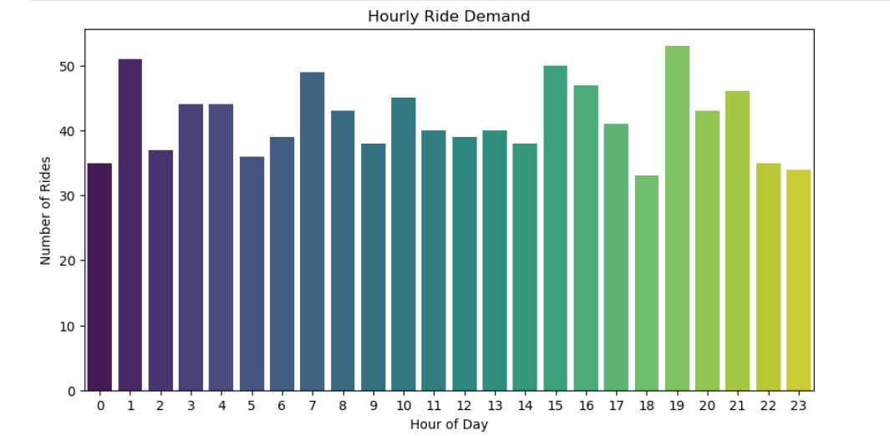
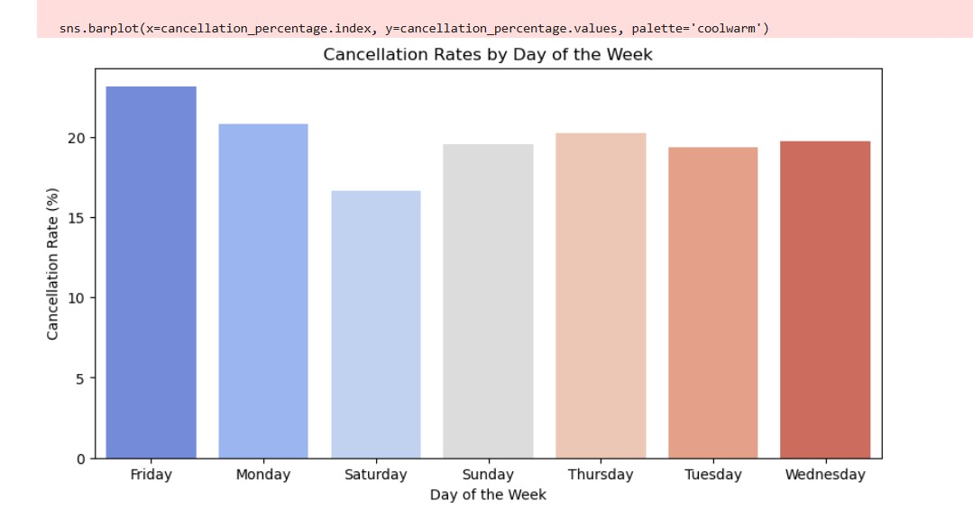
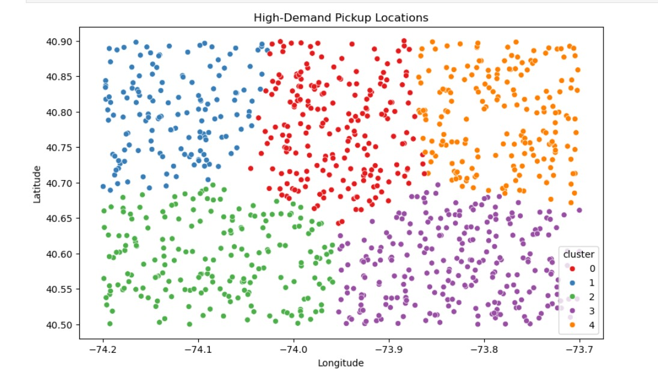
Output

